Slide 1

A Deep Dive into Containerized Model Serving with FastAPI
20220628 - A Deep Dive into Containerized Model Serving with FastAPI
PyLadies Amsterdam
June 28, 2022
Nikki van Ommeren
Karlijn Schipper
20220628 - A Deep Dive into Containerized Model Serving with FastAPI

Slide 2

Agenda
Who are we?
The case: A Deep Dive into Containerized Model Serving with FastAPI
20220628 - A Deep Dive into Containerized Model Serving with FastAPI

Slide 3


Who are we?
Nikki van Ommeren
Karlijn Schipper
20220628 - A Deep Dive into Containerized Model Serving with FastAPI

Slide 4




Karlijn Schipper
Machine Learning Engineer @
20220628 - A Deep Dive into Containerized Model Serving with FastAPI

Slide 5







Vantage AI delivers hands-on customisation in the field of ML and AI to solve business problems
2-year training program
6-12 months assignments
After this program, we transition to (BDR)
Added value of BDR:
Training
Mentorship program
Knowledge sessions
20220628 - A Deep Dive into Containerized Model Serving with FastAPI

Slide 6





Fun stuff
Questions? Find me, or Vantage AI on LinkedIn via this QR code:
20220628 - A Deep Dive into Containerized Model Serving with FastAPI

Slide 7
Agenda
Who are we?
The case: A Deep Dive into Containerized Model Serving with FastAPI
20220628 - A Deep Dive into Containerized Model Serving with FastAPI

Slide 8
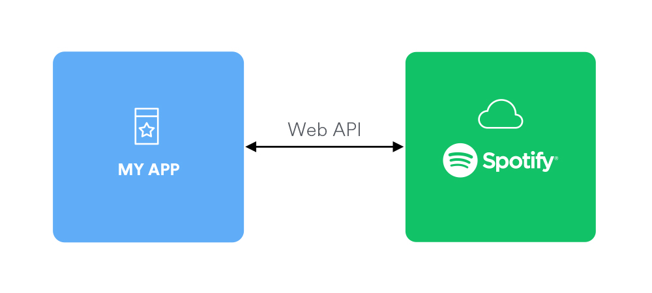

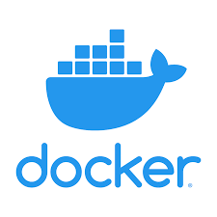
The goal of this workshop is to create an end-to-end Machine Learning solution that recommends Spotify songs
Model
Get spotify data
FastAPI
20220628 - A Deep Dive into Containerized Model Serving with FastAPI

Slide 9
Case overview
Part 0 – Preparation
Part 1 - Create Dockerfile and bash script
Part 2: Create FastAPI
Part 3: Requests, Responses, Error handling, Pydantic
20220628 - A Deep Dive into Containerized Model Serving with FastAPI

Slide 10
Part 0 – Preparation
Create an .env file in the workshop folder
Fill this .env file in with your Spotify credentials
You can get these credentials via yourown app (https://developer.spotify.com/dashboard/applications)
20220628 - A Deep Dive into Containerized Model Serving with FastAPI

Slide 11

Multiple problems can arise if you want to deploy your model
Where to put files on the server?
Different dependencies for the server OS are installed
What other processes etc. are running on the server during your installation?
Different OSs are used when developing the product
What happens when the server changes?
20220628 - A Deep Dive into Containerized Model Serving with FastAPI

Slide 12
Meet Docker
Docker is a framework for containerization
Apps run within a virtual container, separated from other apps
Docker containers run the same on any host machine: they have their own virtual OS installed
Enables microservice architectures: lots of different containers with simple tasks talking through each other through API’s
20220628 - A Deep Dive into Containerized Model Serving with FastAPI

Slide 13
Main benefits of Docker
Containers run the same on any machine
Easy to use
Quickly build and test applications
Lightweight and quick: very little overhead
Enables better scalability
Tools like Kubernetes can be used to manage containers in production environments
20220628 - A Deep Dive into Containerized Model Serving with FastAPI

Slide 14
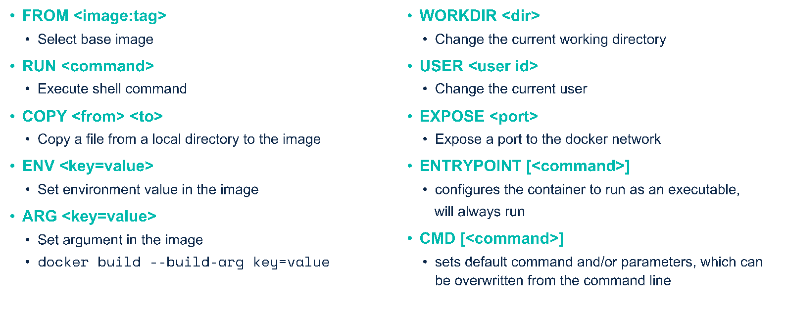
Dockerfile commands
20220628 - A Deep Dive into Containerized Model Serving with FastAPI

Slide 15
Docker commands
docker build –t <tag_name> .
docker run –p 8080:8080 –v <directory>:<directory> <tag_name> bash –c “command”
docker tag <tag_name> <dockerhub_repo>
docker image push <dockerhub_repo>
20220628 - A Deep Dive into Containerized Model Serving with FastAPI

Slide 16

Part 1: Create a containerized solution that prints your most listened song
Complete the Dockerfile
Complete the bash file that builds a Docker image and runs the container
Run the bash file
Authenticate with Spotify API
20220628 - A Deep Dive into Containerized Model Serving with FastAPI

Slide 17
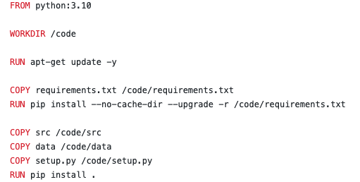
Solutions
20220628 - A Deep Dive into Containerized Model Serving with FastAPI

Slide 18
Solutions
20220628 - A Deep Dive into Containerized Model Serving with FastAPI

Slide 19
What is an API?
Lets applications talk to each other
You can use API’s to:
Get model predictions
Get Spotify data
Send data to your SQL server
Today we’re making an API to serve a ML model
20220628 - A Deep Dive into Containerized Model Serving with FastAPI

Slide 20
What is an API? (II)
Representational State Transfer Application Program Interface
Allows applications to talk to each other over the internet (with http)
Different kinds of requests (API calls):
GET request: gets information from the API
POST requests: sends information and receives a result
PUT/PATCH are used for replacing or updating information
DELETE
20220628 - A Deep Dive into Containerized Model Serving with FastAPI

Slide 21
Return codes
REST API’s work over http, and therefore use http status codes:
200: successful request
400: bad request
401: not authorized
404: not found
500: internal server error
503: service unavailable, etc.
20220628 - A Deep Dive into Containerized Model Serving with FastAPI

Slide 22
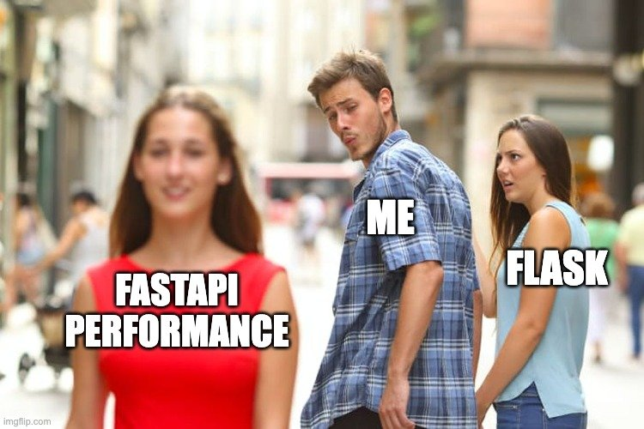
20220628 - A Deep Dive into Containerized Model Serving with FastAPI

Slide 23
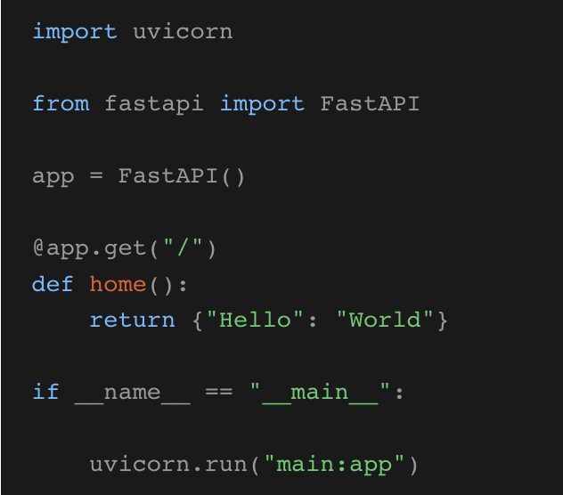
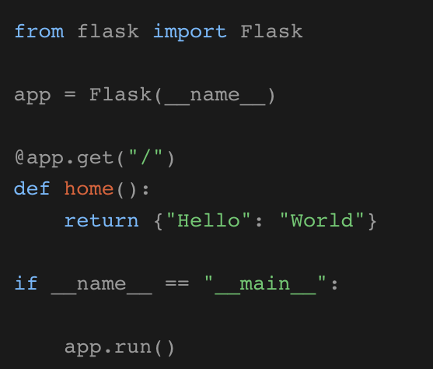
FastAPI vs. Flask
GET&POST requests are very similar
20220628 - A Deep Dive into Containerized Model Serving with FastAPI
Notes:
https://developer.vonage.com/blog/21/08/10/the-ultimate-face-off-flask-vs-fastapi

Slide 24
FastAPI vs. Flask
FastAPI
Automatic, interactive documentation
In-house data validation with Pydantic.
Is asynchronous - no need to wait for other request to be completed. Flask is synchronous.
Flask
Proven and well-tested solution
For web-development: Flask automatically looks for a templates folder where you can display your variables.
20220628 - A Deep Dive into Containerized Model Serving with FastAPI
Notes:
https://developer.vonage.com/blog/21/08/10/the-ultimate-face-off-flask-vs-fastapi
Uses hot reloading, meaning your code changes are immediately visible.

Slide 25
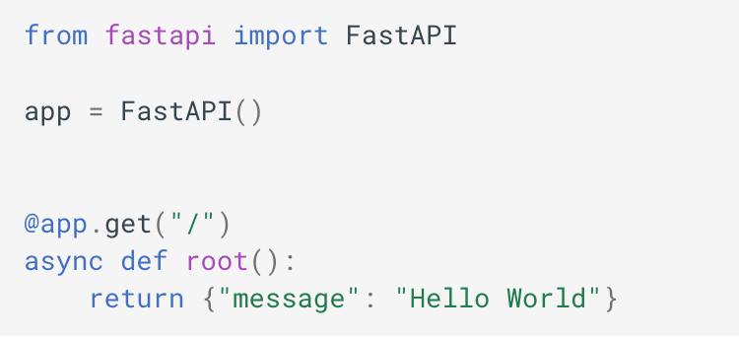
Part 2: Create FastAPI
20220628 - A Deep Dive into Containerized Model Serving with FastAPI

Slide 26
Part 2: Create FastAPI
Object created in main.py
uvicorn src.main:app --host 0.0.0.0 --port 8080 --reload --debug
Refers to file main.py
Makes sure the server restarts after code changes
20220628 - A Deep Dive into Containerized Model Serving with FastAPI

Slide 27
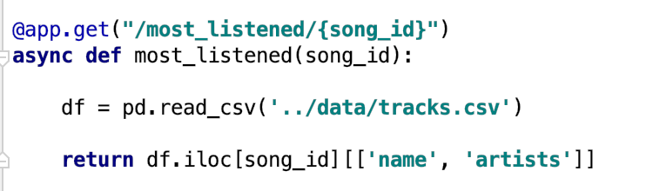
Path parameters
20220628 - A Deep Dive into Containerized Model Serving with FastAPI

Slide 28
Path parameters with types
Required vs. optional
20220628 - A Deep Dive into Containerized Model Serving with FastAPI

Slide 29
Query parameters
20220628 - A Deep Dive into Containerized Model Serving with FastAPI

Slide 30
Interactive docs
20220628 - A Deep Dive into Containerized Model Serving with FastAPI

Slide 31
Interactive docs
20220628 - A Deep Dive into Containerized Model Serving with FastAPI

Slide 32
Exercise 2
Run the FastAPI app
Add a query parameter to one of the existing functions
Call the X function with different query parameters
Try the functions in the interactive docs
20220628 - A Deep Dive into Containerized Model Serving with FastAPI

Slide 33
Solutions
Run the FastAPI app
Add a query parameter to one of the existing functions
Call the X function with different query parameters
Try the functions in the interactive docs
20220628 - A Deep Dive into Containerized Model Serving with FastAPI

Slide 34
Part 3: Requests, Responses, Error handling, Pydantic
20220628 - A Deep Dive into Containerized Model Serving with FastAPI

Slide 35
Requests
20220628 - A Deep Dive into Containerized Model Serving with FastAPI

Slide 36
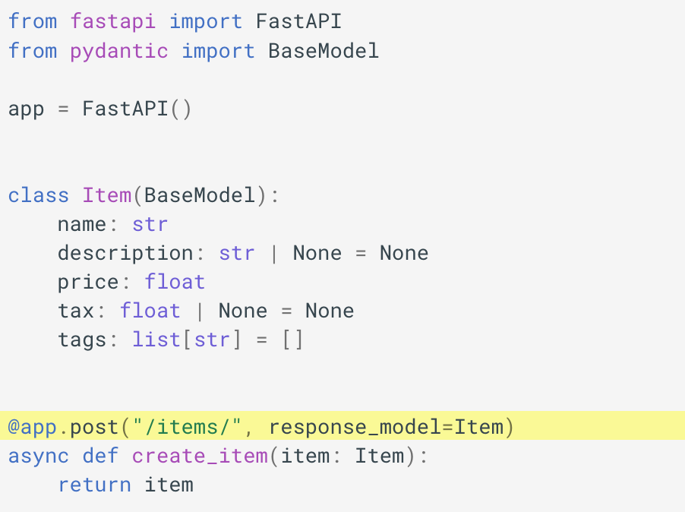
Response model
20220628 - A Deep Dive into Containerized Model Serving with FastAPI

Slide 37
Error handling
20220628 - A Deep Dive into Containerized Model Serving with FastAPI

Slide 38
Pydantic
20220628 - A Deep Dive into Containerized Model Serving with FastAPI

Slide 39
Exercise 3
Create a Enum class for the input of X function
Create your own app function for making predictions
Bonus: Throw an HTTP error when the user attempts to ask for a playlist when no Spotify credentials are provided
Bonus2: Add a PUT function that adds songs to your playlist, the function in music model still needs to be written.
20220628 - A Deep Dive into Containerized Model Serving with FastAPI

Slide 40
Solutions
Create a Enum class for the input of X function
Create your own app function for making predictions
Bonus: Throw an HTTP error when the user attempts to ask for a playlist when no Spotify credentials are provided
Bonus2: Add a PUT function that adds songs to your playlist, the function in music model still needs to be written.
20220628 - A Deep Dive into Containerized Model Serving with FastAPI

Slide 41
Recap
FastAPI is great for type checking
How to use docker
How to use the Spotify Web API
More questions? Connect to us on LinkdIn! Nikki and Karlijn
20220628 - A Deep Dive into Containerized Model Serving with FastAPI

Slide 42
Questions?
20220628 - A Deep Dive into Containerized Model Serving with FastAPI

